Slide 1

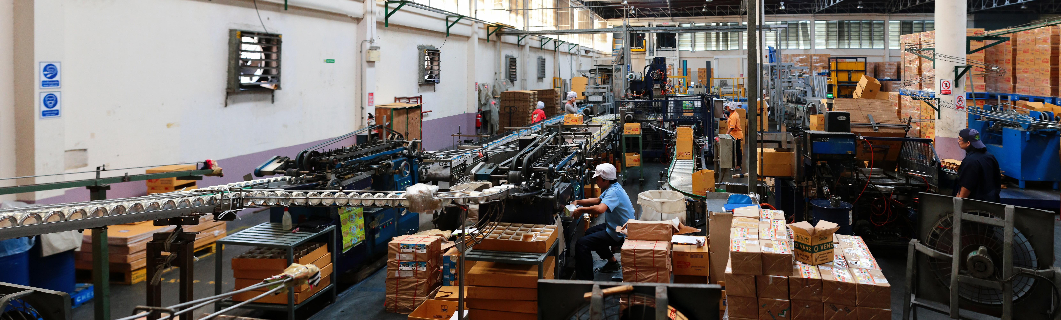
ADVENTURE WORKS
Team Members:
Shazmeen Fathima
Samiksha Bhor
Anupama B R
Meeniga Venkata Rakesh

Slide 2
Introduction
Adventure Work – A Multinational Company . The may Goal was to study the Companies Sales and Profit Performance across various dimensions such as territory, product category, product sub-category . The focus was to transform raw data into actionable insights using tools such as Excel, Power BI , Tableau, and SQL to provide support to decision making.
During the process we explored multiple tables like sales ,sales new , product category ,product sub-category , territory, date and more. Understood relationship between fact and dimension tables .
For better understanding of Data we cleaned the data through power query editor replace the null values , removed unwanted columns , changed the datatype when required and also added columns to tables .
Created Dashboards using Excel, Power BI, Tableau, and also written MYSQL script’s through MYSQL Workbench.
The final Dashboards presents a clear view of sales trends , profit margin and performance across categories and regions.

Slide 3
INDIVIDUAL TEAM UPDATES
TEAM MEMBER | RESPONSIBILITY | WORK DONE | STATUS
SHAZMEEN FATHIMA | Excel, Power BI,SQL script, data cleaning, PowerPoint presentation. | Created dashboard in excel , power BI ,wrote script in SQL , Participated in data cleaning and understanding. Majorly involved in preparing PPT. | Completed
SAMIKSHA BHOR | Power bi , Tableau, created slides and helped in data cleaning . | Developed Dashboards in Excel , tableau ,helped in formatting data. | Completed
ANUPAMA B R | Excel , Tableau , Power bi. | Worked on Excel , Power BI , and created ppt file added title to each slide . | Completed
MEENGIA VENKATA RAKESH | Excel , tableau ,help in data cleaning. | Developed Dashboards in Tableau , and assisted in other tools , Performed excel analysis. | Completed

Slide 4
Challenges Faced During Project
During Project we encountered several Challenges ,which includes following :
Transforming the data and building accurate relationships between tables.
Issue with removing blank cells.
While converting numbers into more readable units .
When we added slicers in the dashboard it was difficult to connect the slicers to all visuals.
In creating SQL script we were unable to load dataset in MYSQL Work bench.
In power bi ,the issue was in calculation where I don’t understand the mistake done in applying formula. And while preparing calendar table we faced difficulties.

Slide 5
POTENTIAL SOLUTIONS
1. Used Power query to transform data into the correct structure.
Created relationship between tables using data modelling techniques .
And implemented star schema approach for clarity and performance .
2. Applied filters in power query to remove null/blank values.
used ISBLANK() to handle blank cells.
3. Applied custom number formatting in excel . ensured uniform units across all visuals.
In order to enhance readability.
4 . While loading data set in SQL we have changed the file format from .xlsx to
.csv format because SQL doesn’t support .xlsx files and also changed the location .
5 . In Power BI I have changed the SUMX formula actually I have added SUMX function twice in the same formula due to which the sales values reached trillions .
After rectifying the error it got corrected and the accurate sales value has been derived.

Slide 6
KEY PERFORMANCE INDICATORS (KPI’S)
1.Total sales - 29.36 Millions
2.Total production Cost - 17.28 Millions
3.Profit Margin -41.15
4.Sales by Country – Australia, US, Canada, ETC.
5.Sales by color – consumer preference by product color.
6.Sales by Product Category – Bikes, Accessories, Clothing.
7.Sales by year – Trends from 2011-2014
This will help the Company
1. Identify Top – Performing Region.
2. Understand Year wise and Quarter wise Sales Trends.
3. Optimize production Cost.
4. Improve strategic decision – making.

Slide 7
INSIGNTS
The total sales recorded across the selected years was 29.96 millions. While the Production cost was around 17.28 millions , Profit Margin of 41.15%.
We also analysed , sales trends by year, which have showed a steady increase in revenue ,with a peak in 2013.
The Product Category (BIKES
) Contributed The highest portion of both sales and production cost , followed by accessories
Sales by Colour , where Black and Red emerged as the most popular choices among customers.

Slide 8
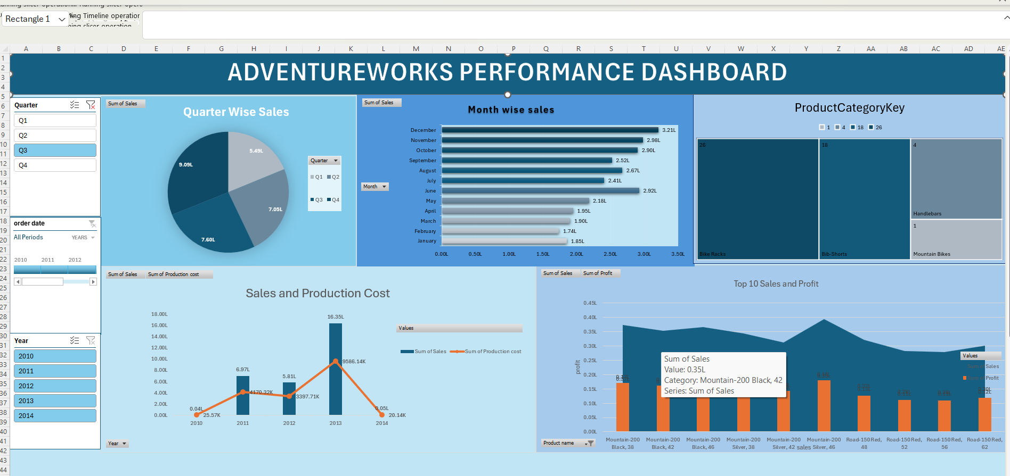
Excel Dashboard

Slide 9
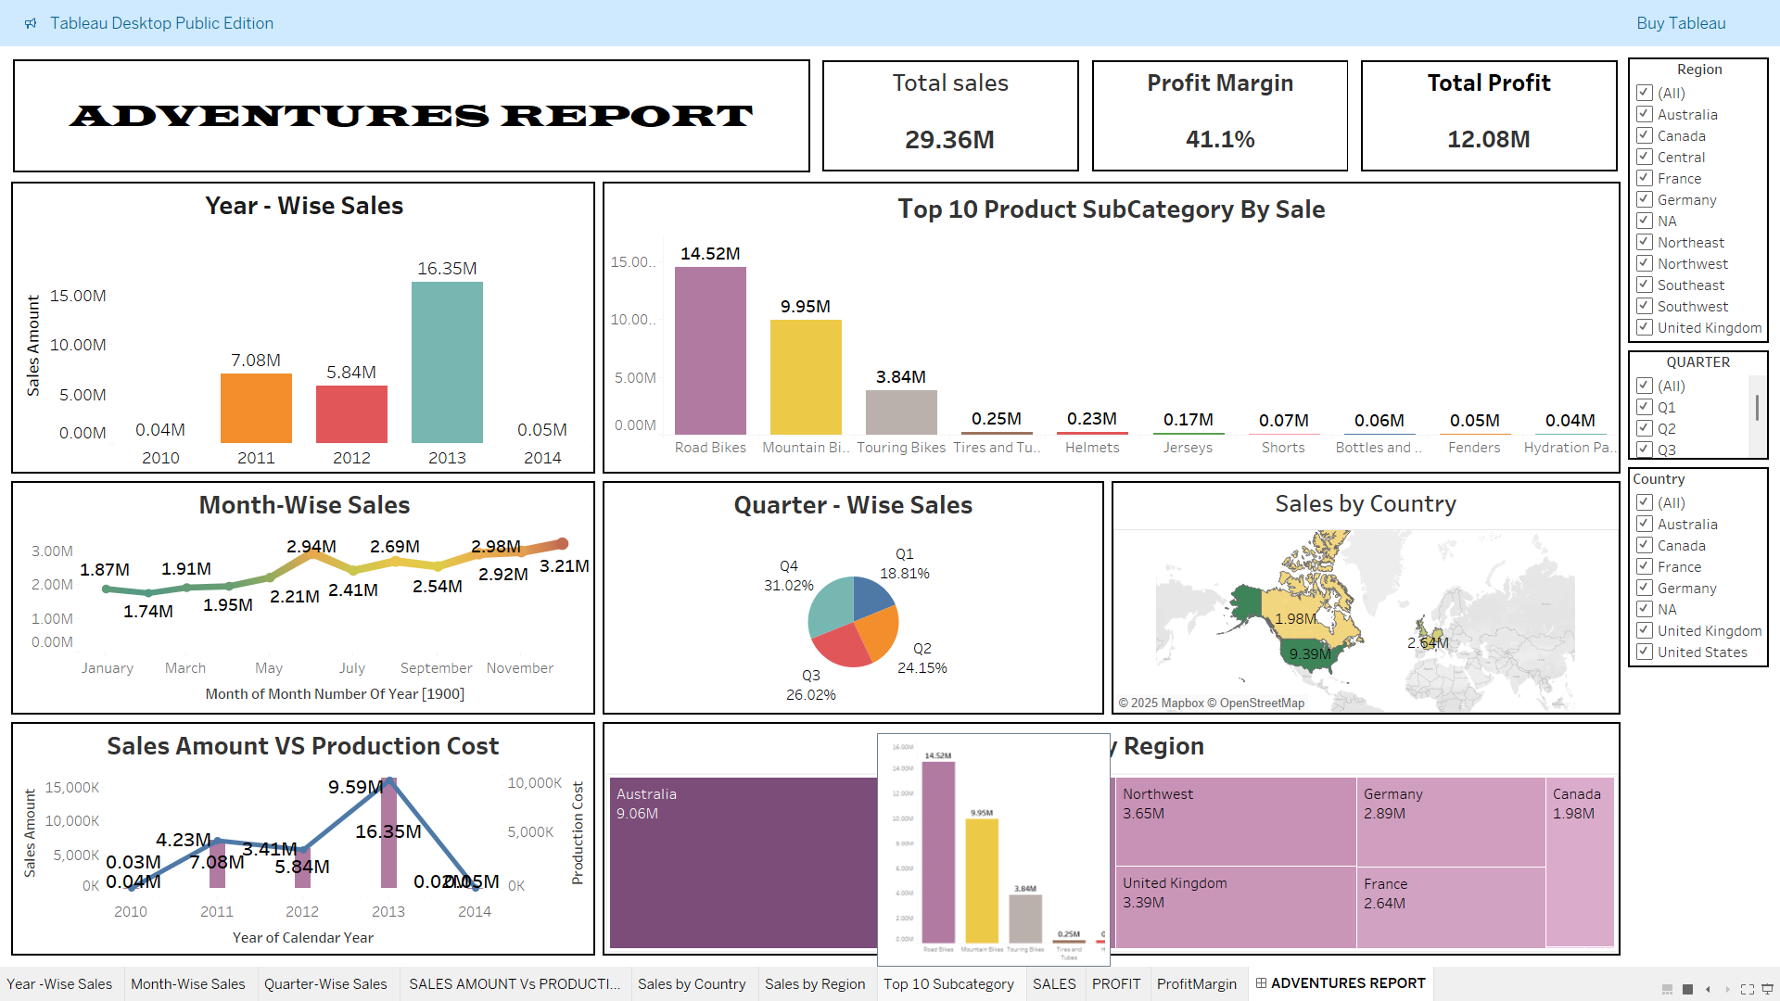
Tableau Dashboard

Slide 10
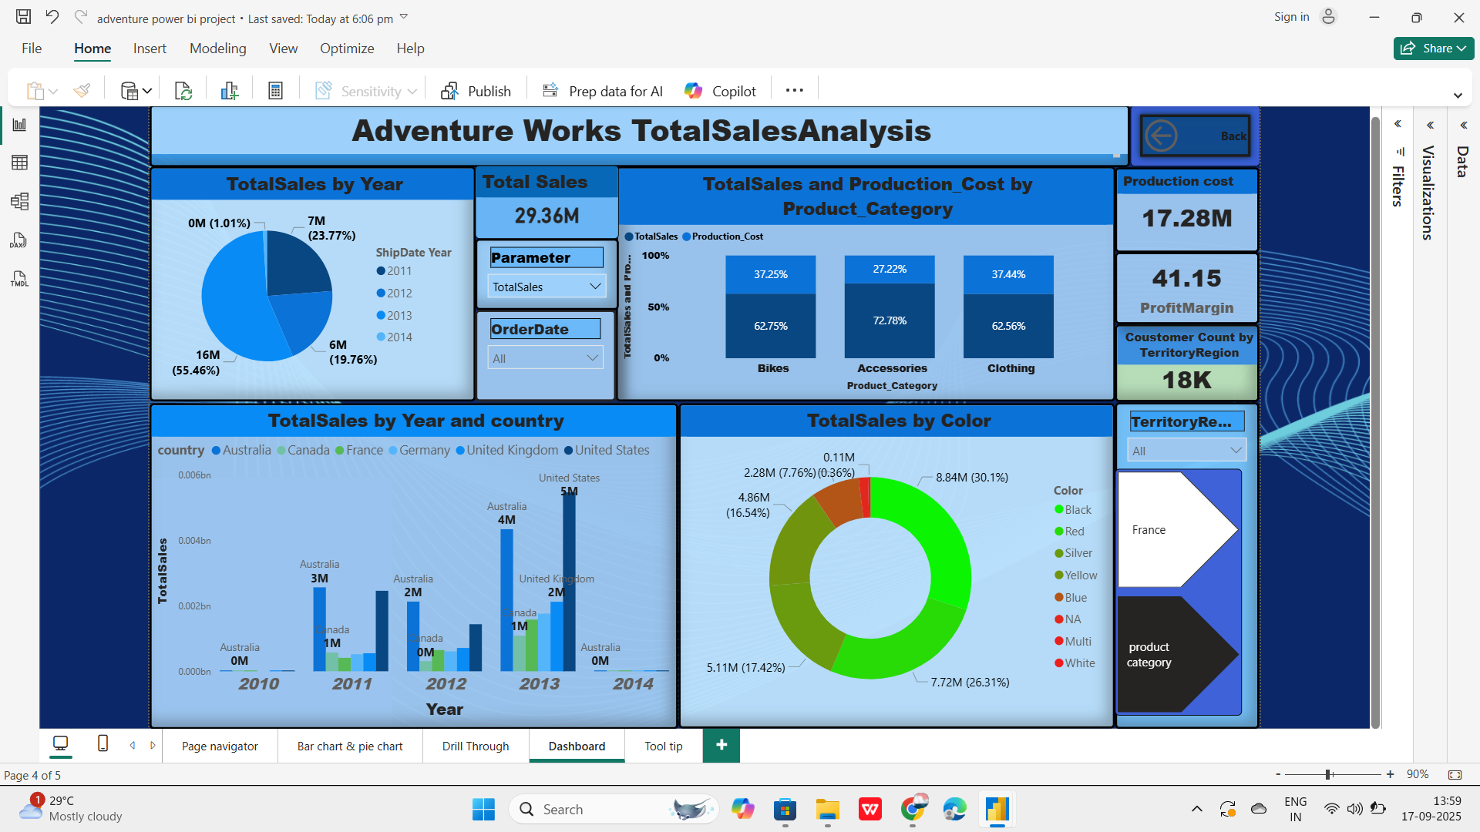
Power BI Dashboard

Slide 11
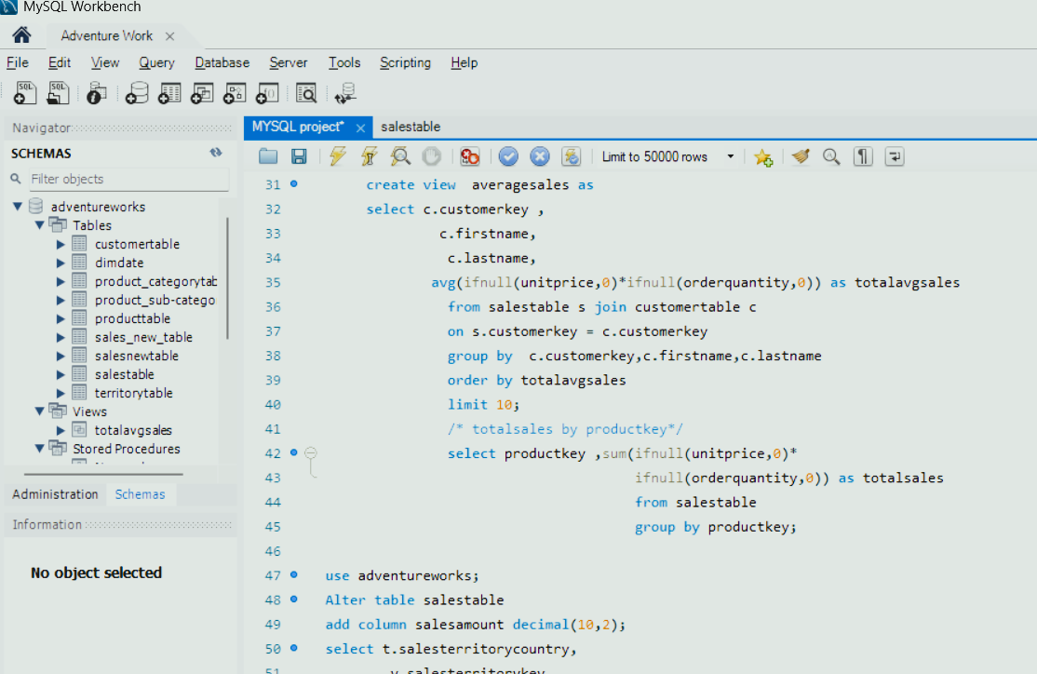
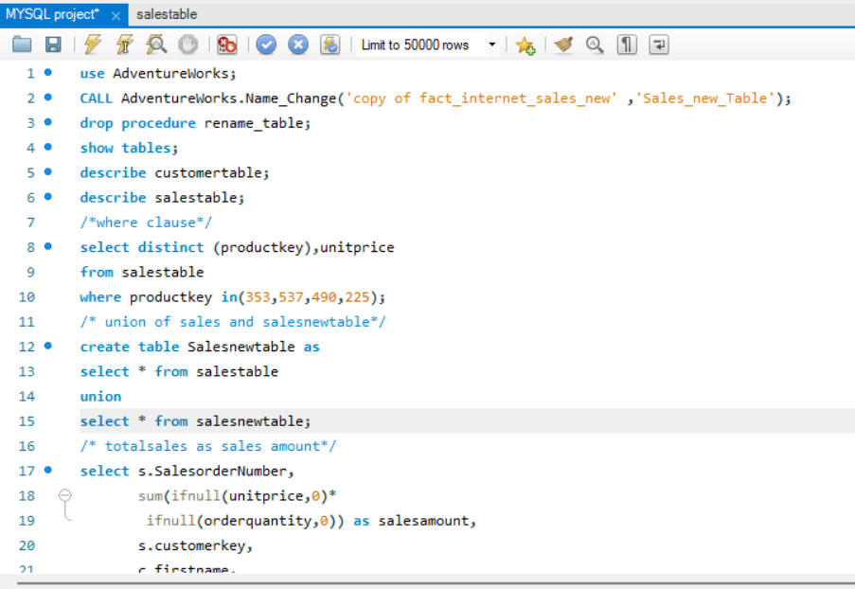
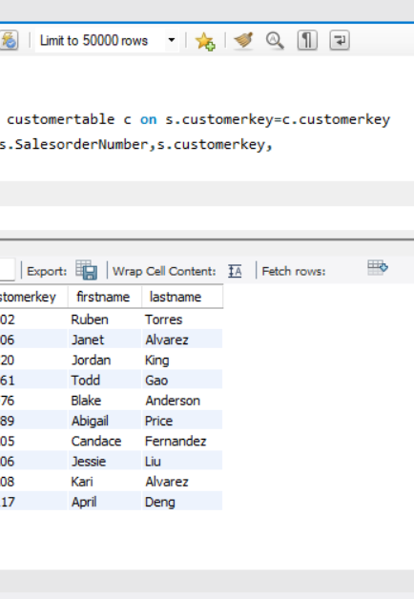
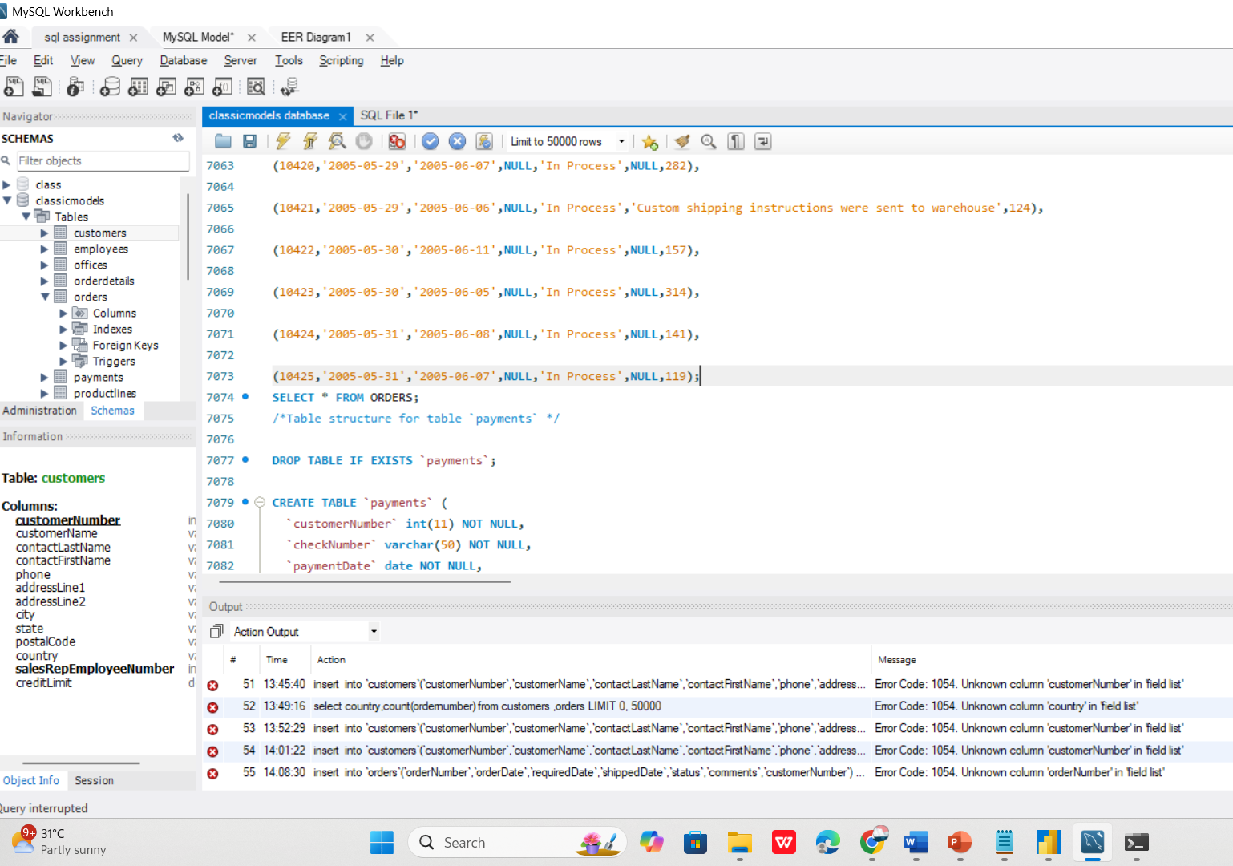
SQL QUERIES

Slide 12
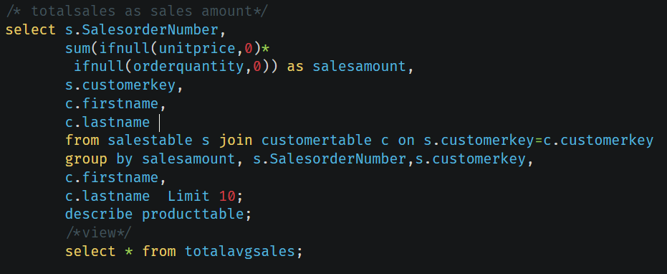

Slide 13
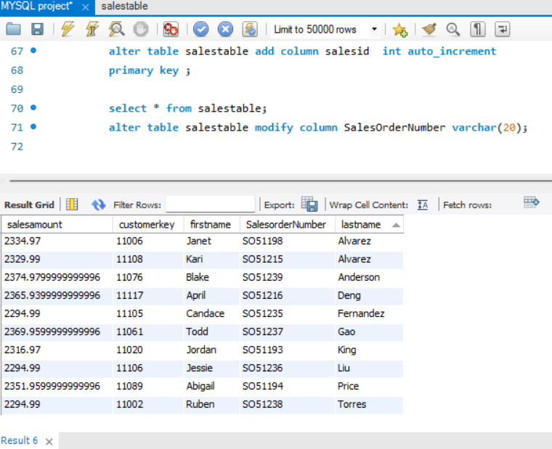
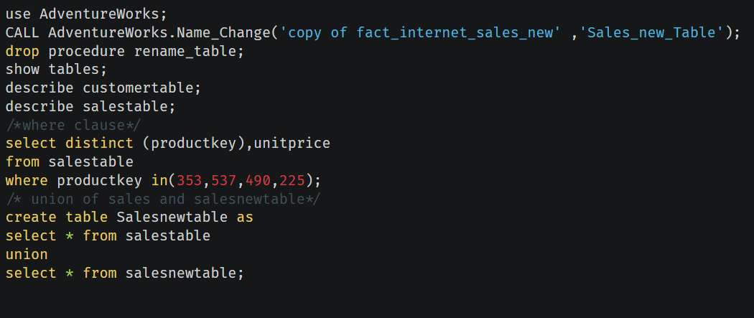

Slide 14
Summary
Modeled and joined datasets (Customer, Product, Sales, etc.) for analytics.
Developed dashboards using Excel (Pivot, Macros), Power BI (DAX, Filters), and Tableau (Calculated Fields).
Wrote efficient SQL queries for data extraction, aggregation, and reporting.
Analyzed customer segmentation, sales patterns, and cost drivers.
Enabled data-driven decisions with optimized reporting and visualization tools

Slide 15

Thank You

